Slide 1

Überblick Microsoft Cloud Adoption Framework
Manage

Slide 2
Plan
An iterative process that supports your business … as it evolves
Govern
Manage
Define strategy
Adopt
Ready

Slide 3
Manage and operations
Define strategy
Plan
Ready
Adopt
Manage and operations enumerates, implements, and iteratively reviews related to the expected operational behavior of the service.
Govern
Manage
Define business commitments
Document supported workloads to establish operational commitments with the business and agree on cloud management investments for each workload.
Establish a management baseline:
Define the criticality classifications, cloud management tools, and processes required to deliver your minimum commitment to operations management.
Expand the management baseline:
Based on business commitments and operations decisions, make use of the included best practices to implement the required cloud management tooling.
Advanced operations and design principles:
Platforms or workloads that require a higher level of business commitment might require a deeper architecture review to deliver on resiliency and reliability commitments.

Slide 4
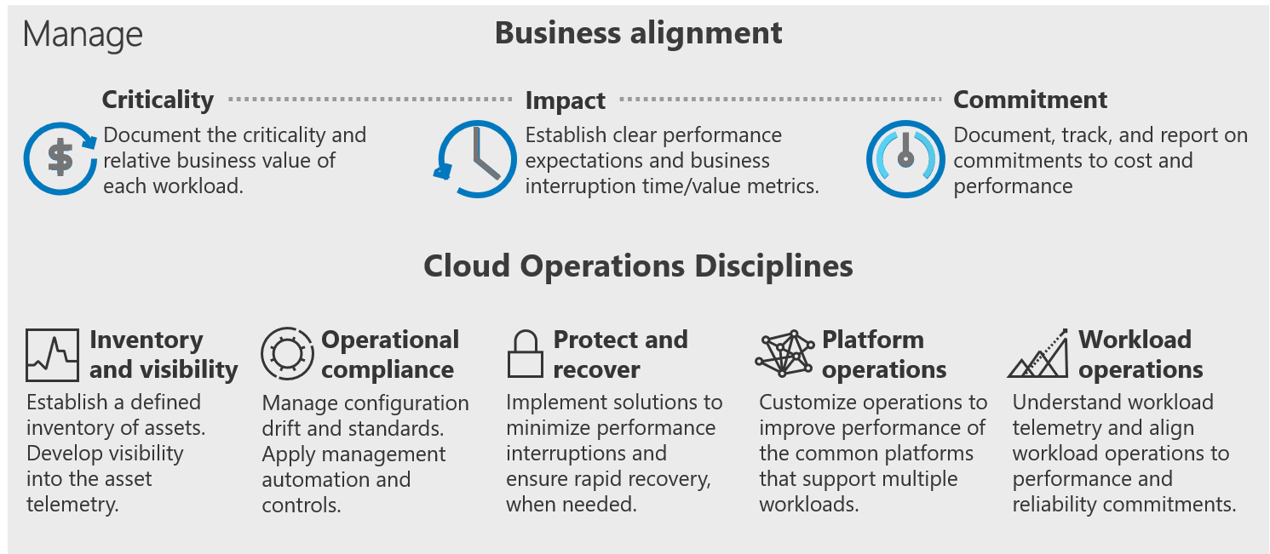
Cloud Adoption Framework's Manage methodology

Slide 5
Manage

Slide 6
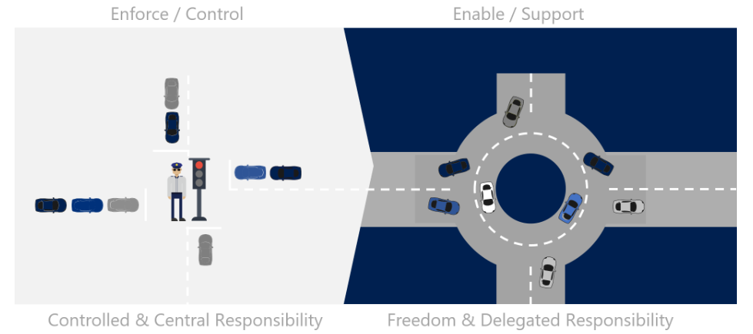
Evolution of the IT Business Model
The cloud is causing a paradigm shift in the function of Operations Management

Slide 7
Cloud management
Operations management for cloud and hybrid solutions
Cloud Adoption Framework
Expand IT management and operations to ensure cloud-based solutions can be operated through secure, cost-effective processes using modern, cloud-first tools.

Slide 8
Methodology to enable cloud management
Cloud operations disciplines
Business alignment
1
Criticality
Establish management baseline
Management
baseline
Inventory and visibility
Operational compliance
Protect and recover
Impact
Enhanced baseline
Platform specialization
Workload specialization
Advanced
operations
Commitment
Expand management baseline
Advanced operations and design principals
Define business commitments
3
4
2

Slide 9
Management baseline
Why do you need this?
A well-guided management baseline defines a set of cloud management tools and processes required to deliver your minimum commitment to operations management.
Goals for management baseline
Define the basic tools needed for managing operations around any Azure production environments
Focus on the minimum options and processes necessary instead of all the available options
Use the management baseline to apply resource consistency across different resources on the Azure platform

Slide 10
Inventory and visibility
Management baseline
Azure tools and services
Service health
Log analytics
Azure change tracking and inventory service
Azure activity log
Azure monitor for VMs
Azure network watcher
DNS analytics
Create an inventory of assets across multiple clouds, and develop deep visibility into the run state of each asset
Each monitoring tool has been configured with proper access and scope for each operations team
Each asset must be inventoried and classified towards stable operations
Centralization of logging drives reports about change management, service health, and configuration for IT operations
Awareness and understanding of technical changes across multiple workloads is essential for reliable operations
Understand the telemetry about the stability, performance, and operations of the workload, and the assets which support the workload
Inventory and visibility
Management
baseline

Slide 11
Operational compliance
Management baseline
Establish controls and processes to ensure each state is properly configured and running in a well-governed environment
Azure tools and services
Azure Primitives
Azure automation
Azure update management service
Azure policy
Azure blueprint
Streamline and update management solutions to schedule and control all required updates to be deployed
Ensure policy enforcement across configuration of operating systems, applications, and underlying environments
Get automated compliance for core services to enforce operational compliance in an environment
Effective operational compliance requires consistency:
Established resource consistency with resource organization and tagging
Consistent environment or landing zones enforced through automated tools
Resource configuration consistency with ongoing monitoring and evaluation processes
Updated consistency with scheduling, controlling, and automating necessary updates
Automated remediation to reduce cloud management efforts and increase user satisfaction
Operational compliance
Management
baseline

Slide 12
Protect and recover
Management baseline
Ensure all managed assets are protected and can be recovered using baseline management tooling
Azure tools and services
Azure Backup
Azure Site Recovery
Protect and recover business critical workloads in the cloud to anticipate and prepare for a potential workload outage
Define plans to back up, protect, and recover your data and VMs in Azure
Get short- and long-term backup without the need to deploy complex on-premises backup solutions
Replicate VMs and workloads to the secondary location to ensure business continuity
Failover to secondary location, and access apps and workloads even during outages
Protect and recover
Management
baseline

Slide 13
Business alignments and commitments
Why do you need this?
Business alignment with cloud management is required to rethink commitments to operational management in partnership with the business.
Goals for management baseline
Document the criticality and relative business value of each workload
Establish clear performance expectations and business interruption time/value metrics
Document, track, and report on commitments to cost and performance

Slide 14
Methodology to enable cloud management
Cloud operations disciplines
Business alignment
1
Criticality
Establish management baseline
Management
baseline
Inventory and visibility
Operational compliance
Protect and recover
Impact
Enhanced baseline
Platform specialization
Workload specialization
Advanced
operations
Commitment
Expand management baseline
Advanced operations and design principals
Define business commitments
3
4
2

Slide 15
Define business criticality
Business alignment
Azure tools and services
Operations management workbook
Map workloads to business processes and rank their criticality to focus investments
Understand the criticality of each workload in the IT portfolio to identify missing critical workloads
Create a criticality scale for criticality with business and categorize them with custom criticality classifications
Define default criticality to apply to all workloads and ensure criticality classification doesn't block your broader cloud strategy
Use pre-defined templates to record the criticality scale, define default criticality, and provide the correct value to reflect any deviations
Business alignment
Criticality

Slide 16
Understanding business impact
Business alignment
Azure tools and services
Operations management workbook
Understand the impact of potential outages to aid in evaluating return on investment for cloud management
Business impact serves as a prioritization variable when recovering systems during an outage.
Calculate impact time depending on the nature of workloads, from high to low frequency of workload usage
Calculate the total business impact more accurately with three approaches, including adjusted losses, historical losses, and complete loss calculation
Calculate workload impact, which must be attributed across each of the workloads
Business alignment
Impact

Slide 17
Establish business commitments
Business alignment
Azure tools and services
Operations management workbook
Develop true partnerships by creating and documenting agreements with the business
Define business commitment by aligning the proper level of operational management at an acceptable operating cost
Commitments to business stability, via technical resiliency or other SLA impacts, are a business justification decision
Establish commitment with the business by aligning the following aspects:
IT operations prerequisites
Management responsibility
Cloud tenancy
Soft-cost factors
Loss avoidance ROI
Validation of management level
Business alignment
Commitments

Slide 18
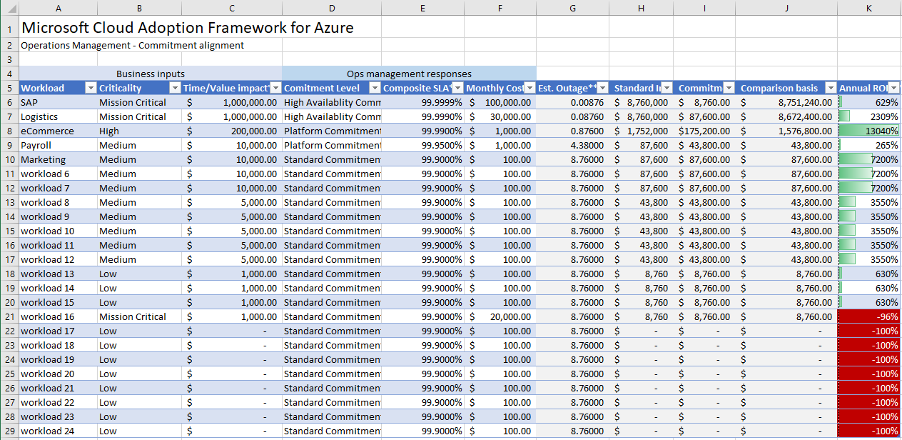
Ops Management planning workbook
Help capture decisions that result from business alignment conversations
1
2
3

Slide 19
Methodology to enable cloud management
Cloud operations disciplines
Business Alignment
1
Criticality
Establish management baseline
Management
baseline
Inventory and visibility
Operational compliance
Protect and recover
Impact
Enhanced baseline
Platform specialization
Workload specialization
Advanced
operations
Commitment
Expand management baseline
Advanced operations and design principals
Define business commitments
3
4
2

Slide 20
Enhance management baseline
Why do you need this?
Outline a minimum viable product (MVP) for cloud management services, referred to as a management baseline, and add common improvements to the baseline.
Goals for management baseline
In addition to management baseline, improve business commitments with enhanced management baseline
Improve uptime and decrease recovery times for the entire portfolio of workloads with cloud-native tools

Slide 21
Methodology to enable cloud management
Cloud operations disciplines
Business Alignment
1
Criticality
Establish management baseline
Management
baseline
Inventory and visibility
Operational compliance
Protect and recover
Impact
Enhanced baseline
Platform specialization
Workload specialization
Advanced
operations
Commitment
Expand management baseline
Advanced operations and design principals
Define business commitments
3
4
2

Slide 22
Enhanced baseline
Advanced operations
Azure tools and services
Azure Resource Graph
IT Service Management Connector
Azure Automation
Azure Automation Hybrid Runbook Worker
Desired State Configuration (DSC)
Azure Security Center
Evaluate common additions to the baseline that might meet business needs
Use enhanced management baseline cloud-native operations tools and processes to extend the business commitment
A number of mission-critical workloads might require enhancements to the management baseline for better commitment
Enhanced baseline can be enabled to perform advanced management operations and processes such as:
Service change tracking
ITSM integration
Operations automation
Multi-cloud operations
Guest automation
Breach notification
Enhanced baseline
Advanced
operations

Slide 23
Advanced operations and design principles
Why do you need this?
Management specialization is required to improve the design of common systems (platforms) or specific workloads to effectively minimize interruptions.
Goals for management baseline
Improve the resiliency and design of business workloads
Detect trends and provide automated remediation
Create repeatable solutions to minimize maintenance overhead
Use advanced monitoring tools to discover incremental improvements

Slide 24
Methodology to enable cloud management
Cloud Operations Disciplines
Business Alignment
1
Criticality
Establish management baseline
Management
baseline
Inventory and visibility
Operational compliance
Protect and recover
Impact
Enhanced baseline
Platform specialization
Workload specialization
Advanced
operations
Commitment
Expand management baseline
Advanced operations and design principals
Define business commitments
3
4
2

Slide 25
Platform specialization
Advanced operations
Azure tools and services
Azure Managed Applications
Azure Monitor for containers
Azure SQL analytics
SQL Server health check
Azure Automation
Azure Architecture Framework
Invest in ongoing operations of a specific workload, generally reserved for mission-critical workloads
Platform specialization consists of a disciplined execution of the following processes in an iterative approach:
Improve the design of common systems (platforms) or specific workloads by considering best practices for architecture frameworks with Azure Architecture Frameworks
Minimize business interruptions with Azure Architecture Framework by improving systems designs with scalability, availability, resiliency, security, and management
Automate remediation and reduce the impact of interruptions
Scale changes across the environment through the service catalog
Discover incremental improvements to address in the next pass of system design, automation, and scale
Platform operations
Platform specialization

Slide 26
Workload specialization
Advanced operations
Azure tools and services
Azure Monitor logs
Application Insights
Azure Automation
Azure Architecture Framework
Invest in ongoing operations of a shared platform, distributing the investment across multiple workloads
Trigger a cultural change in traditional IT build processes that focus on delivering a management baseline, enhanced baselines, and platform operations
Apply best practices for improving the resiliency and design of a specific system with Azure Architecture Frameworks
Get the flexibility of advanced monitoring of options for monitoring performance, availability, usage, and dependencies
Operational tasks shift to an application-development or business-unit organization
Application insights—to get deep insights on the specific workload—are required to provide clear workload operations
Workload operations
Workload specialization

Slide 27




Microsoft Well-Architected— Build and manage high-performing workloads
Azure
Well-Architected
Review
Reliability
Design
Principles
Azure
Advisor
Cost Optimization
Azure
Well-Architected
Framework
Operational Excellence
Performance Efficiency
Security
Reference
Architectures
Documentation
Partners, Support &
Service Offers
Notes:
<Key point> With the Well-Architected Framework you can BUILD workloads with confidence based on proven deep technical guidance, that is actionable and simple-to-use, and helps you identify areas of improvement, and where to focus your workloads optimization efforts.​
​
<Talking points>​
The framework is at the center of an ecosystem of best practices, documentation, assessments, reference architecture, and design principles. All this supported and amplified by Partners and Services offers to guide and assist you in improving your workloads’ quality.​
​
Azure Well-Architected Framework enables you to achieving your business objectives, operationalizing how to design, build, and optimize cloud solutions.​
Microsoft Azure Well-Architected Review provides evaluates workloads with gap analysis and identifies areas of where to focus your optimization efforts.​
Reference Architectures help you to build and deploy any workload to scale and meet your business needs.​
Design principles based on proven practices and design patterns from successful customer and partner deployments.​
Microsoft Partner & Service Offers support you—and help you build effective cloud solutions.​
<Transition> What exactly does the Framework enable in terms of building Well-Architected workloads?

Slide 28
Resources
Learn more about the Microsoft Cloud Adoption Framework and cloud management.
What
Where
Microsoft Cloud Adoption Framework for Azure: Introduction
https://azure.microsoft.com/cloud-adoption-framework/
Microsoft Cloud Adoption Framework for Azure: Documentation
https://docs.microsoft.com/azure/cloud-adoption-framework/
Cloud management in the Cloud Adoption Framework
https://docs.microsoft.com/azure/cloud-adoption-framework/manage/
Azure Architecture Review
https://docs.microsoft.com/assessments/?id=azure-architecture-review

